Slide 1
Regression Analysis
Other Regression Methods
Nicoleta Serban, Ph.D.
Associate Professor
Stewart School of Industrial and Systems Engineering
Time Series Regression

Slide 2
About this lesson

Slide 3
Multiple Linear Regression
Data: {(x₁₁,.., x_{1p}),Y₁},….,{(x_{n1},.., x_{np} ),Y_{n}}
Model: Y_{i} = β₀ + β₁x_{i1} + β₂x_{i2} +…+ β_{p}x_{ip} + ε_{i}, i =1,…,n
What if uncorrelated errors assumption does not hold?
Degrees of freedom are not equal to the sample size
Higher variability or uncertainty than estimated thus less reliable statistical inference
Assumptions:
Linearity/Mean Zero Assumption: E(ε_{i}) = 0
Constant Variance Assumption: Var(ε_{i}) = σ²
Independence Assumption: {ε₁,…, ε_{n}} are independent random variables
Normality Assumption: ε_{i} ~ Normal

Slide 4
Example: Time Series
Correlation in time:
US yearly GDP
Monthly sales of Australian red wine
Monthly accidental deaths in the U.S.
Monthly interest rates in the U.S.
Daily Average Temperature from La Harpe station in Hancock County, Illinois
Daily stock price of IBM stock
1-minute intraday S&P500 return

Slide 5
Time Series: Characteristics
Trend: long-term increase or decrease in the data over time
Seasonality: influenced by seasonal factors (e.g. quarter of the year, month, or day of the week)
Periodicity: exact repetition in regular pattern (seasonal series often called periodic, although they do not exactly repeat themselves)
Cyclical trend: data exhibit rises and falls that are not of a fixed period
Heteroskedasticity: varying variance with time
Correlation: positive (successive observations are similar) or negative (successive observations are dissimilar)

Slide 6
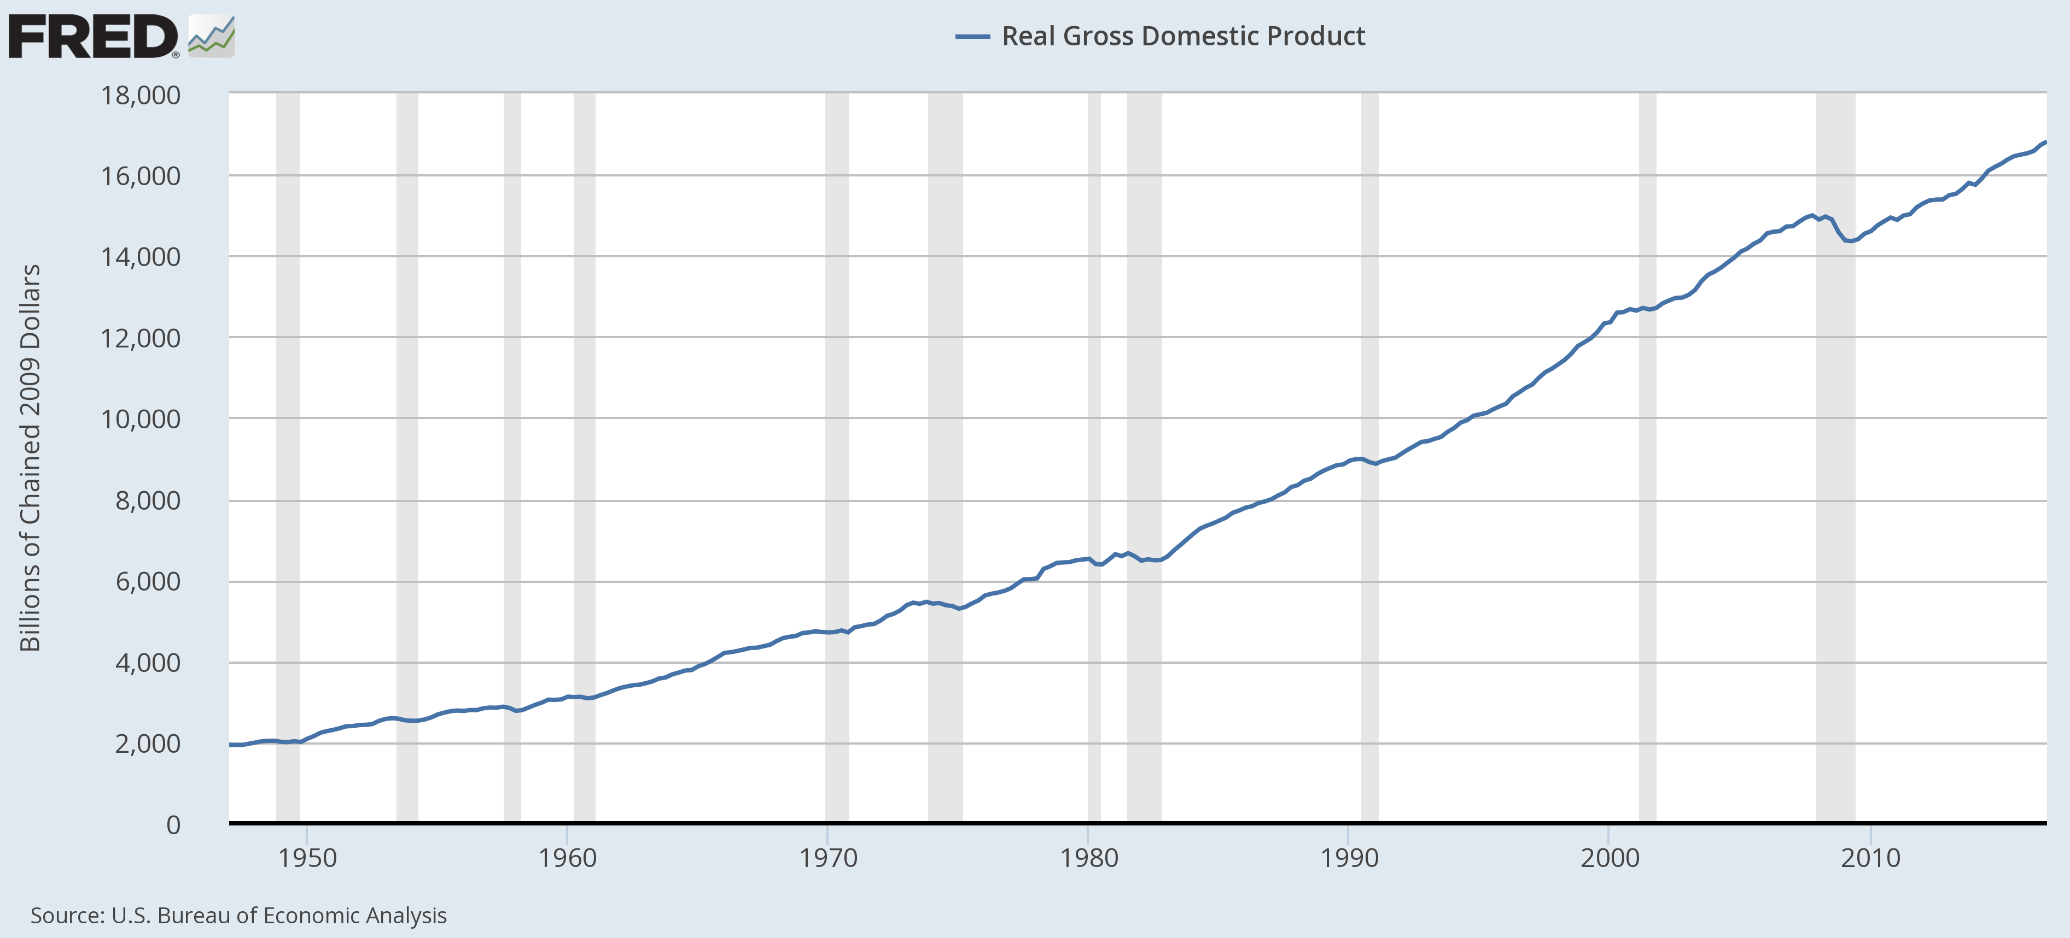
Example: GDP

Slide 7
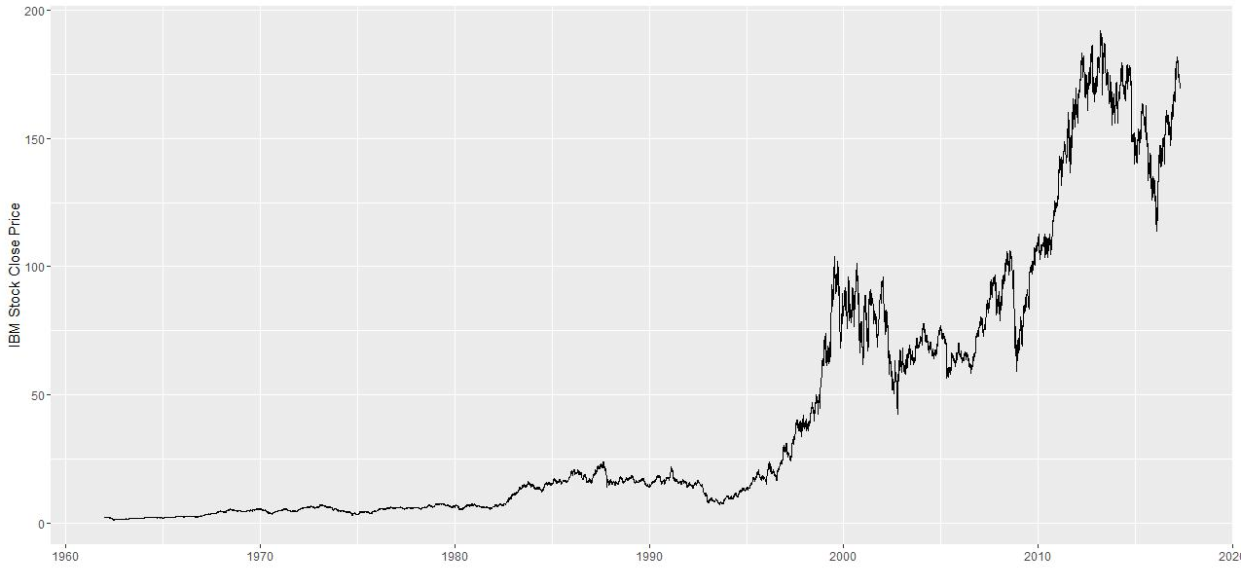
Example: Daily IBM Stock Price

Slide 8
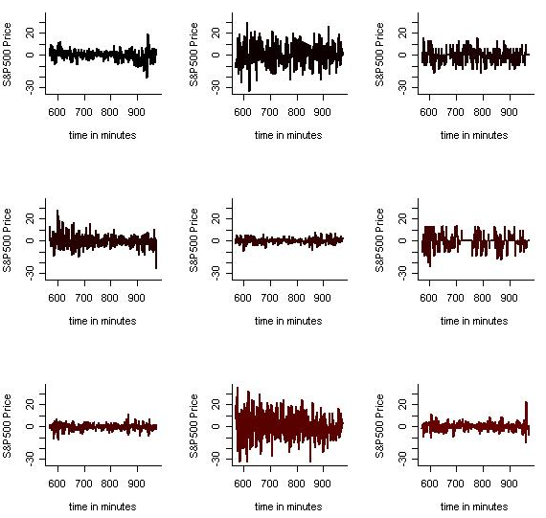
Example: S&P500 Intraday

Slide 9
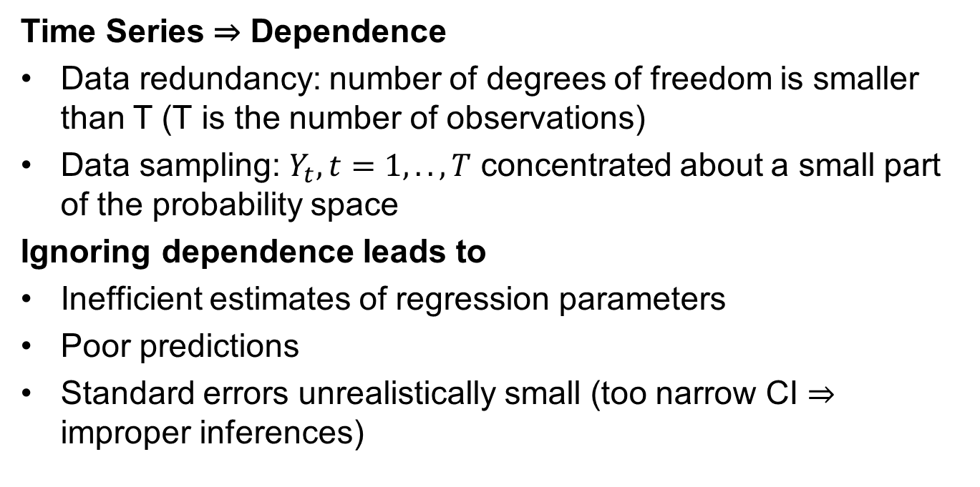
Is Time Series Analysis Necessary?
Time Series ⇒ Dependence
Data redundancy: number of degrees of freedom is smaller than T (T is the number of observations)
Data sampling: $Y_{t}, t=1,..,T$ concentrated about a small part of the probability space
Ignoring dependence leads to
Inefficient estimates of regression parameters
Poor predictions
Standard errors unrealistically small (too narrow CI ⇒ improper inferences)

Slide 10
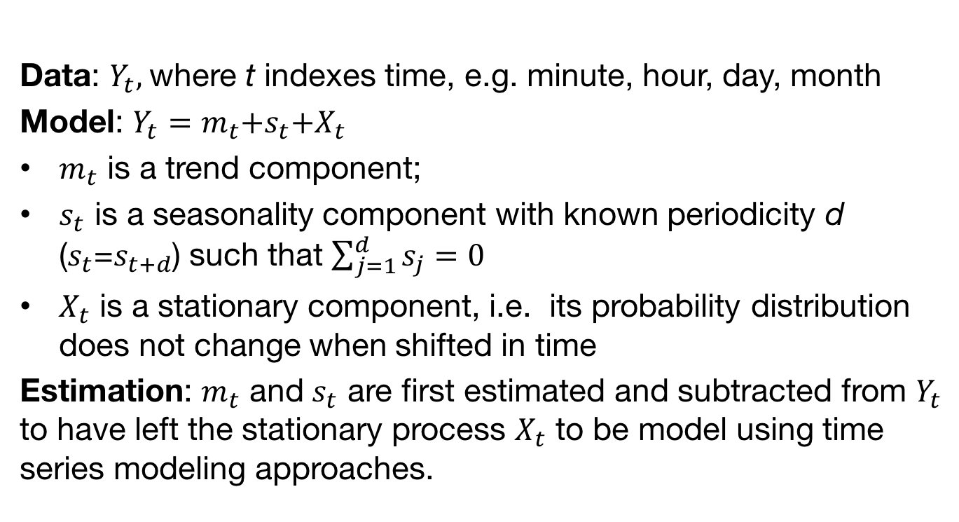
Time Series: Basics
Data: $Y_{t},$where t indexes time, e.g. minute, hour, day, month
Model: $Y_{t}$ = $m_{t}$+$s_{t}$+$X_{t}$
$m_{t}$ is a trend component;
$s_{t}$ is a seasonality component with known periodicity d ($s_{t}$=$s_{t+d}$) such that $\sum_{j=1}^{d}{s_{j}}=0$
$X_{t}$ is a stationary component, i.e. its probability distribution does not change when shifted in time
Estimation: $m_{t}$ and $s_{t}$ are first estimated and subtracted from $Y_{t}$ to have left the stationary process $X_{t}$ to be model using time series modeling approaches.

Slide 11
Summary

